Slide 1
ENHANCING ROAD SAFETY
USING IMAGE PROCESSING TECHNIQUES

Slide 2



ENHANCING ROAD SAFETY
USING IMAGE PROCESSING TECHNIQUES
K MUGUNTHAN
AAROON D SANJU
P NAVEEN
TEAM MEMBERS

Slide 3
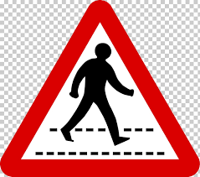
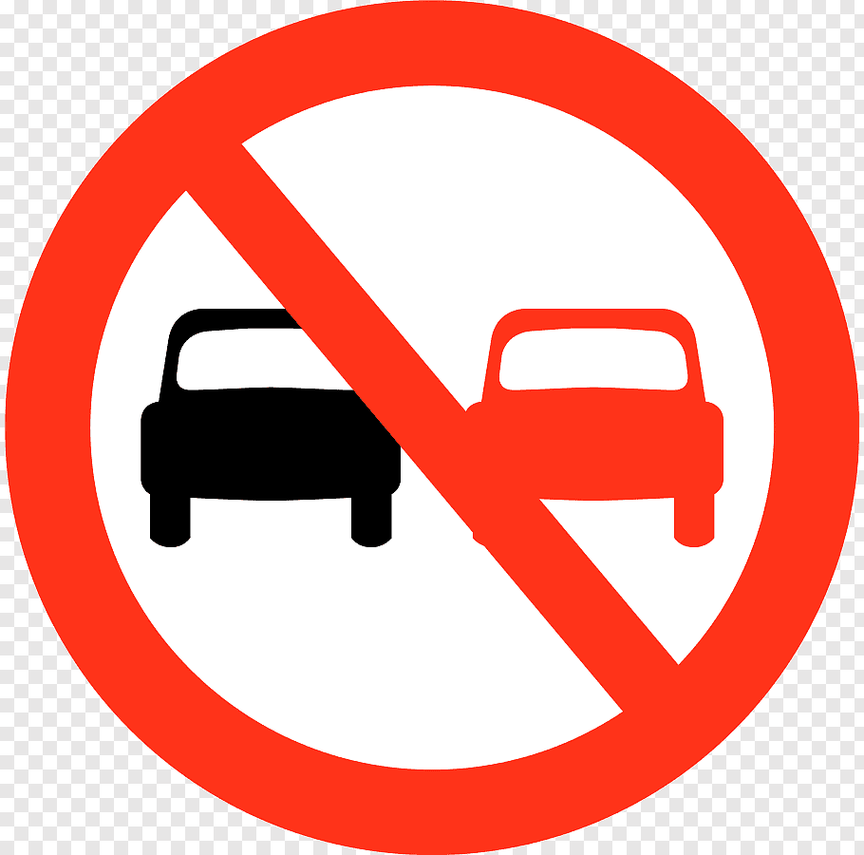
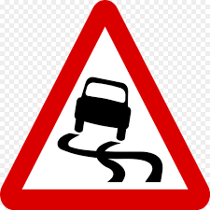
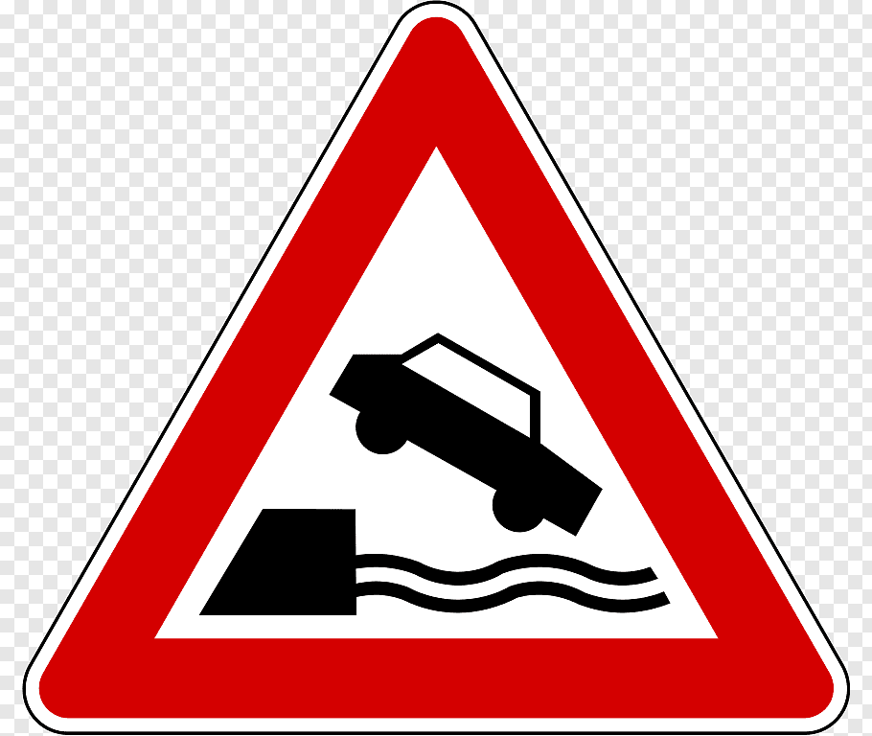

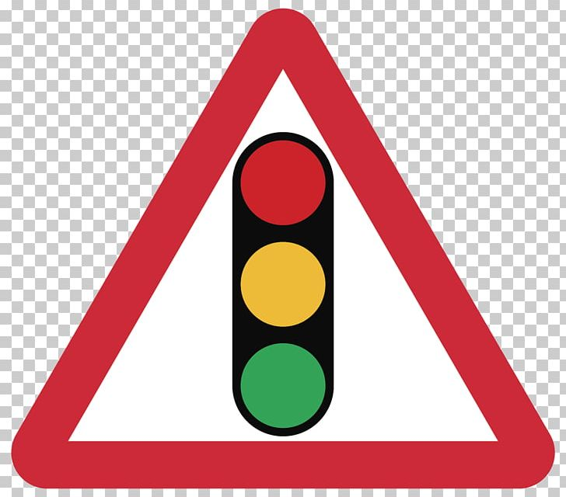
INTRODUCTION
Driver drowsiness detection is a car safety technology which helps prevent accidents caused by the driver getting drowsy. Various studies have suggested that around 20% of all road accidents are fatigue-related, up to 50% on certain roads.
Automatic number-plate recognition is a technology that uses optical character recognition on images to read vehicle registration plates to create vehicle location data. It can use existing closed-circuit television, road-rule enforcement cameras, or cameras specifically designed for the task.
5

Slide 4
INTRODUCTION
Smart Helmet :
The impact when a motorcyclist involves in a high speed accident without wearing a helmet is very dangerous and can cause fatality.With this reason, this project is specially developed as to improve the safety of the motorcycle's rider.
Motorcyclist will be alarmed when the speed limit is exceeded. A Force Sensing Resistor (FSR) and BLDC Fan are used for detection of the rider's head and detection of motorcycle's speed respectively. Only when the rider buckled the helmet then only the motorcycle's engine will start. A LED will flash if the motor speed exceeds 100 km/hour.

Slide 5
EXISTING SYSYEM
The existing detector detects only 40% of face of driver in normal driving position in video recording of 10 minutes.
It uses the old technology and hence there will be minimal accuracy towards detection.
The purpose of this systematic review paper is recognition and categorization of the best possible techniques.
The population of systematic review consists of research papers relevant to drowsiness detection.

Slide 6
PROPOSED SYSYEM
The proposed system is to detect closed eyes to observe drivers fatigue and alert the driver with a buzzer and vibration on positive detection
When the eyes were detected closed for too long, a warning signal is issued.
Driver drowsiness can be determined from several symptoms that manifest in drowsy drivers face.
Through the analysis of the eye status, the system will be able to tell whether the driver is drowsy or not.
Initially when the camera is in on state, video streams are continuously captured from the drivers face.

Slide 7
Literature Survey-1
A Smartphone-Based Drowsiness Detection and Warning System for Automotive Drivers
This paper presents a smartphone-based system for the detection of drowsiness in automotive drivers
The system uses near infrared lighting for illuminating the face of the driver during nightdriving.
The second step uses the voiced to the unvoiced ratio obtained from the speech data from the microphone, in the event PERCLOS crosses the threshold.
Author:Anirban Dasgupta , Member, IEEE, Daleef Rahman, and Aurobinda Routray , Member, IEEE

Slide 8
Literature Survey-2
Driver drowsiness detection system
Drowsiness and Fatigue of drivers are amongst the significant causes of road accidents. Every year, they increase the amounts of deaths and fatalities injuries globally.
In this paper, a module for Advanced Driver Assistance System (ADAS) is presented to reduce the number of accidents due to drivers fatigue and hence increase the transportation safety.
this system deals with automatic driver drowsiness detection based on visual information and Artificial Intelligence.
Author: Belal Alshaqaqi ; Abdullah Salem Baquhaizel ; Mohamed El Amine Ouis

Slide 9
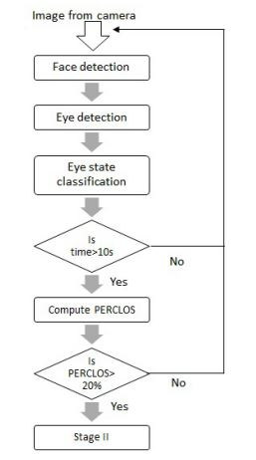
DROWSY DRIVER
DETECTION
FLOWGRAPH

Slide 10
MODULE 1

Slide 11
DROWSY DRIVER DETECTION
Applications
This can be used by riders who tend to drive for a longer period of time that may lead to accidents
Code Requirements
The example code is in Python (Version 2.7 or higher will work).
Dependencies
import cv2
import imutils
import dlib
import scipy

Slide 12
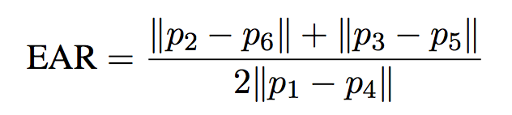
Description
A computer vision system that can automatically detect driver drowsiness in a real-time video stream and then play an alarm if the driver appears to be drowsy.
Algorithm
Each eye is represented by 6 (x, y)-coordinates, starting at the left-corner of the eye (as if you were looking at the person), and then working clockwise around the eye.

Slide 13
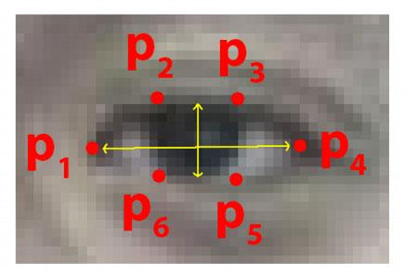
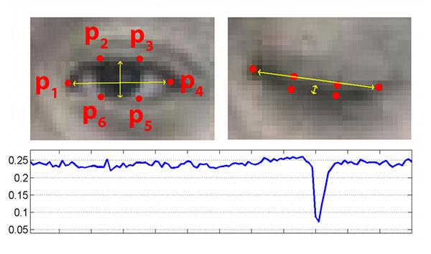
WORKING PROCESS

Slide 14
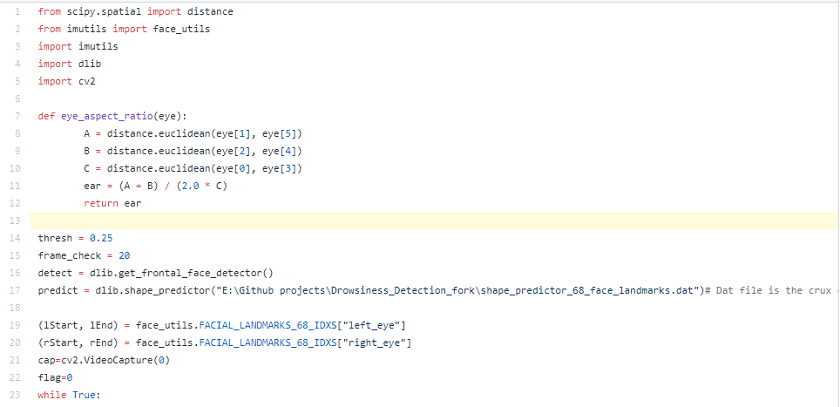
DROWSY DRIVER DETECTION SAMPLE CODE

Slide 15
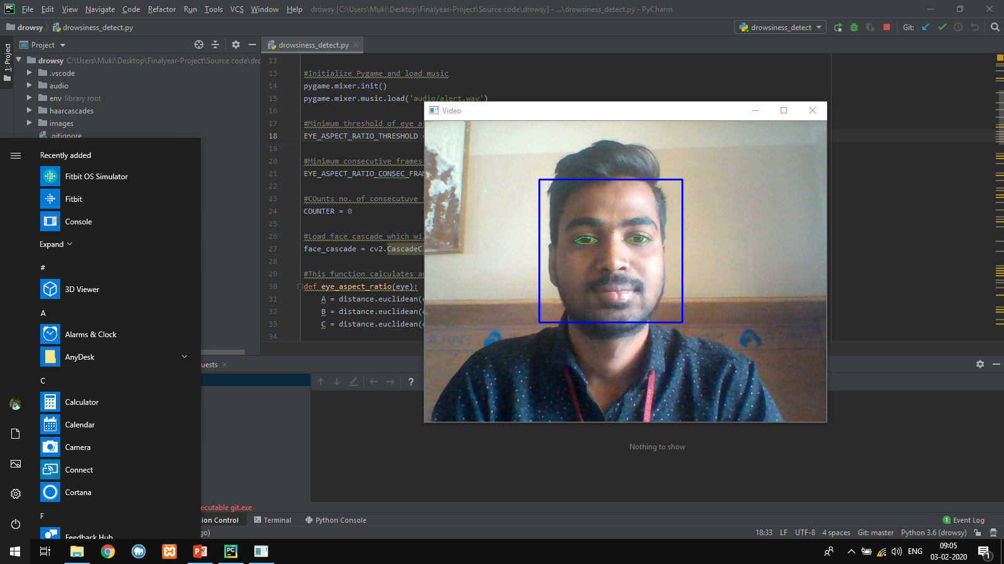
Screen Shots

Slide 16
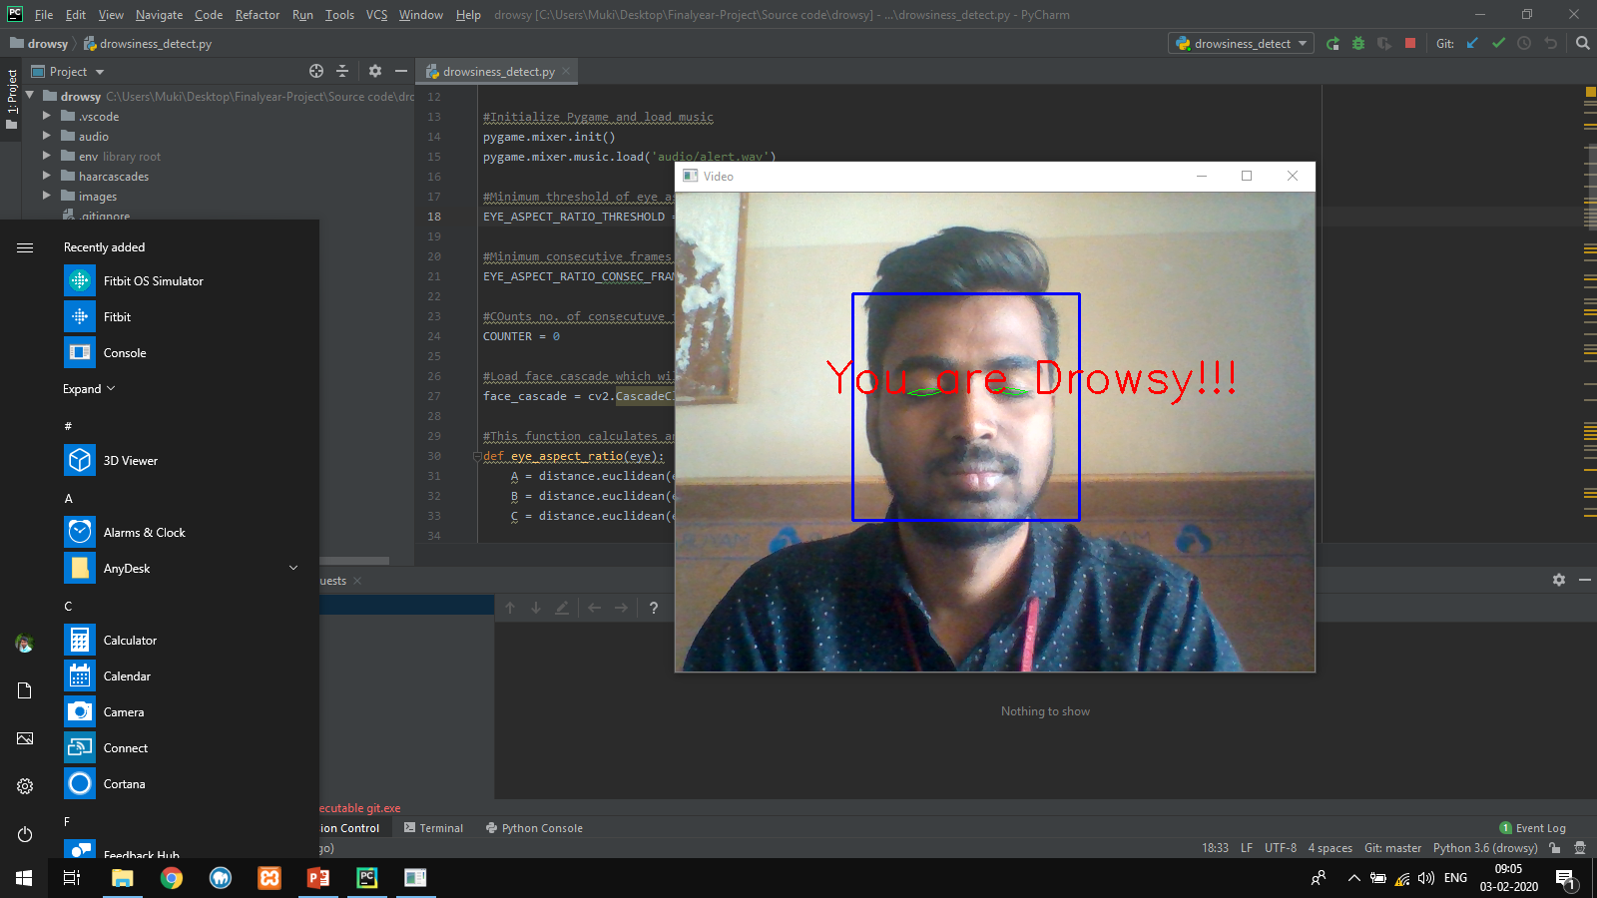
Screen Shots

Slide 17


Slide 18
THANK
YOU

